Slide 1


House price prediction

Slide 2

Introduction
The Real-estate sector
What help can the Technology do in this sector
Steps followed in our research
Explanatory data analysis (EDA)
Feature engineering
Modelling

Slide 3

Research Questions
The following research questions have been formulated to achieve the study’s goal
Which machine-learning algorithm works better and produces the most accurate results for predicting home prices? And why?
What variables have influenced property values over time?

Slide 4
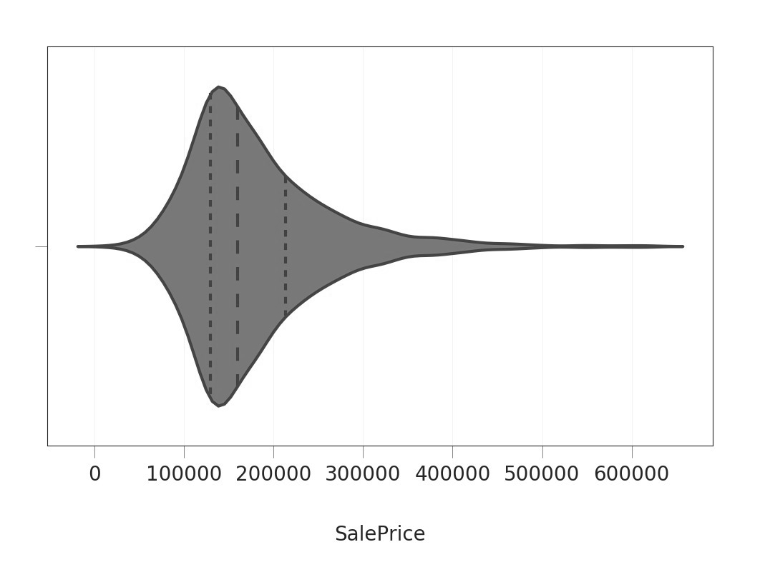
Results
Dataset
Exploratory Data Analysis
Target Variable

Slide 5
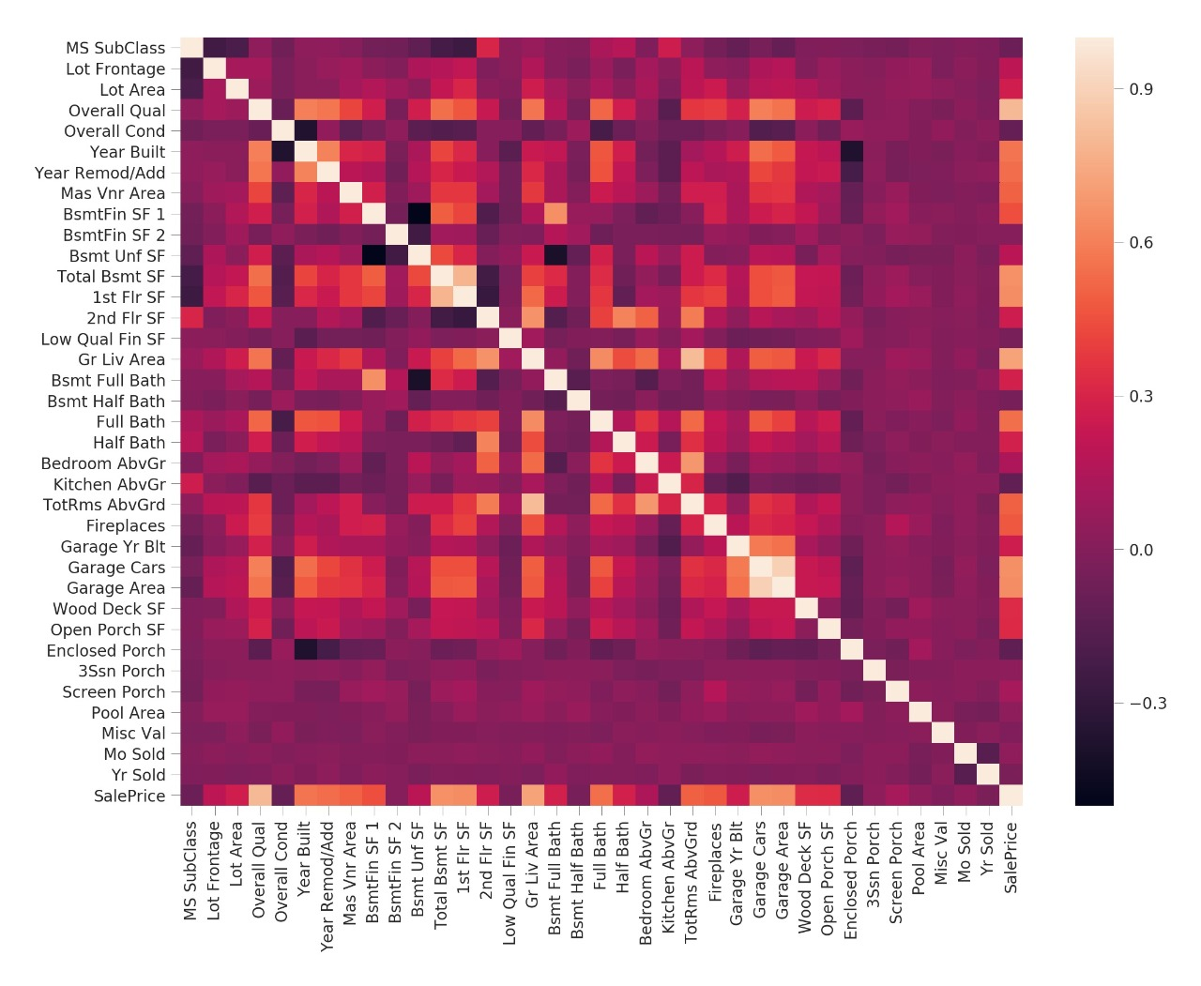
Heat map
A number between -1 and +1 is used to express correlation
strong positive association between garage cars and garage area
strong positive correlation between Gross Liveable Area and Total Rooms Above Ground
Bsmt Unf SF and BsmtFin SF 1 are inversely associated

Slide 6
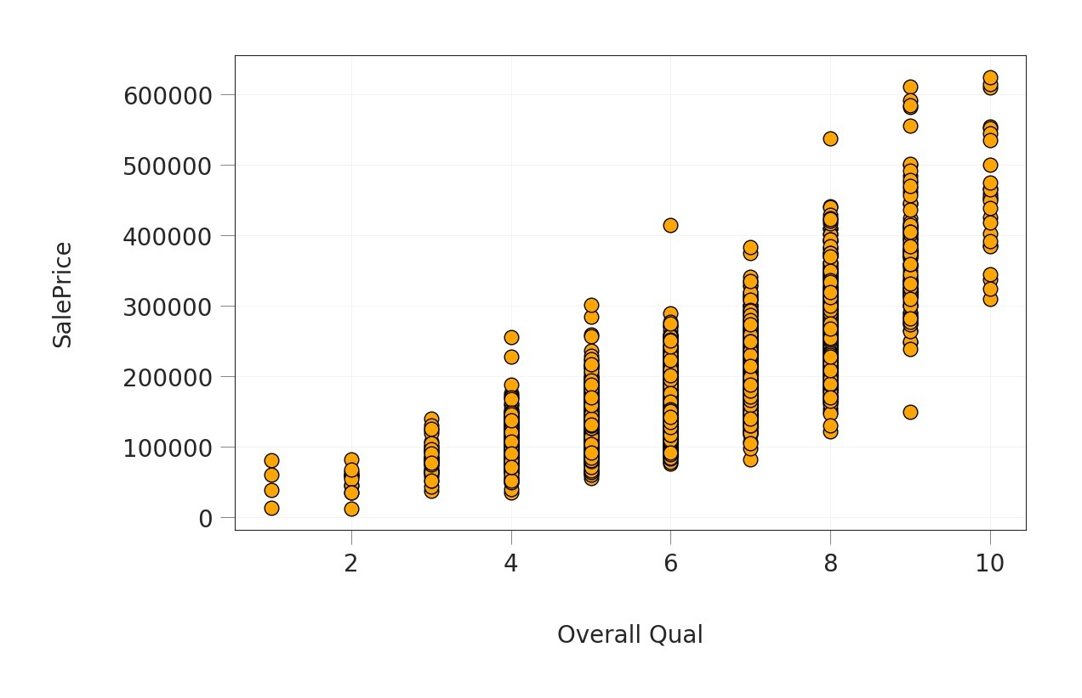
Overall quality V_{s} sale price
The majority of homes get an overall performance around 5 and 7, according to Overall Qual, which accepts integer values from 1 and 10

Slide 7
Engineering Features
New Derived Features Creation
Managing Ordinary Variables

Slide 8
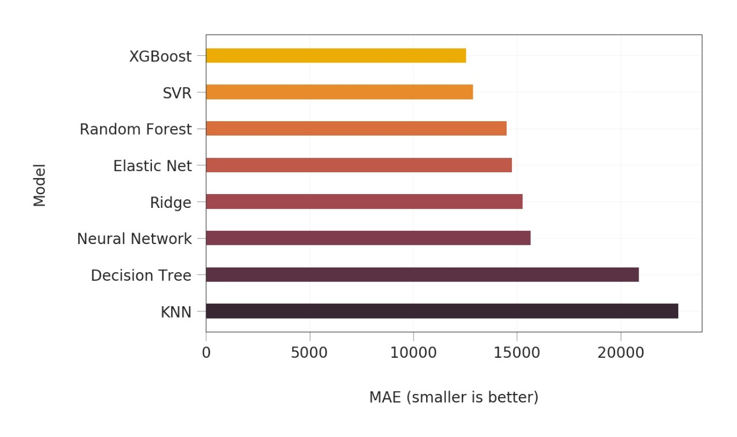
Comparison and Analysis
Models Used and their accuracies

Slide 9
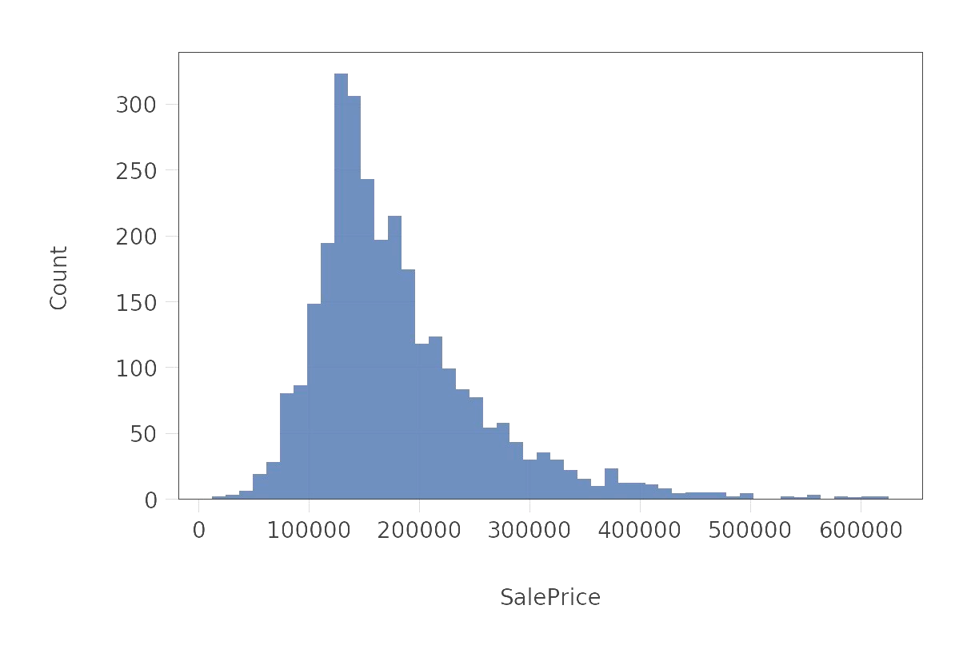
Interpretation of performance
Average value of model uncertainties
SalePrice
count | 2193
mean | 179846.7
std | 79729.38
min | 12789
25% | 128500
50% | 159895
75% | 214000
max | 625000

Slide 10


Thank You!

